Slide 1

Event Processing Course
Current state of the practice (related to chapter 10)

Slide 2
Outline
StreamBase
Sybase (formerly Coral8 then Aleri)
Apama
RuleCore
IBM WebSphere Business Events (WBE)
Microsoft StreamInsight
Esper (EsperTech)
ETALIS

Slide 3
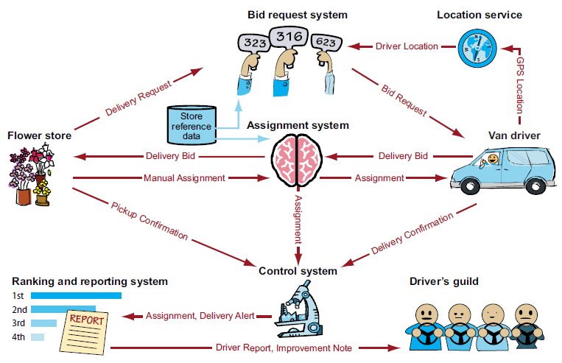
FFD Scenario

Slide 4

StreamBase
Background
A VC owned company that focuses mainly on capital markets.
A derivative of an academic project in MIT/Brown/Brendeis called “Aurora”.
Currently the largest “pure play CEP” in the market.
Last year (2010) it won a prestigious innovation award in Davos.
Started as StreamSQL it migrated its IDE to be based on some variation of event processing network, called Event Flow, but the primitives are still closely related to the SQL concepts.
Notes:
Free downloadable after registration.

Slide 5
StreamBase – cont.
StreamBase Server – core processing engine
StreamSQL – SQL-like language for stream-event manipulations
  Queries against stored data
  Queries against real-time streams
  Queries over time windows
  Built-in operators
StreamBase adapters – connects to variety of source feeds
  XML, CSV, Excel, SQL, JMS
  Custom – Java, C++, .NET
StreamStudio – IDE for application authoring and debugging
  Eclipse based

Slide 6
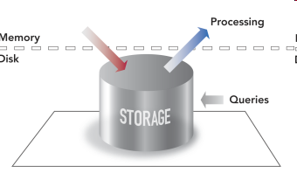
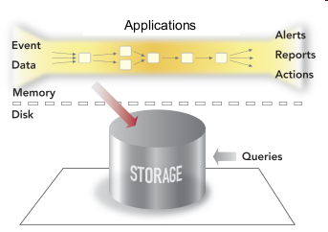
Inbound Processing Model

Slide 7
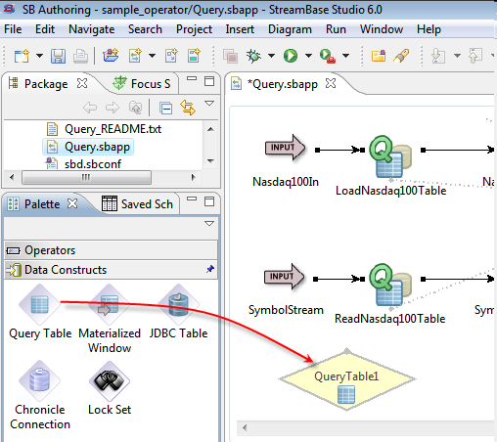
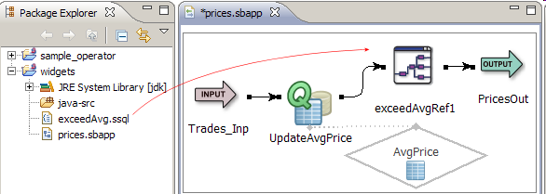
StreamBase Studio

Slide 8
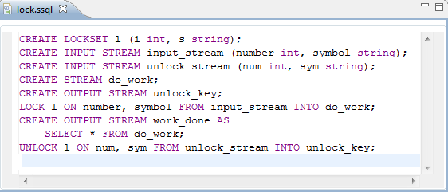
StreamBase Studio

Slide 9
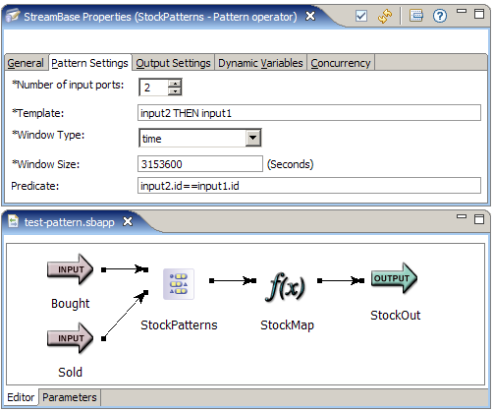
Pattern Matching

Slide 10
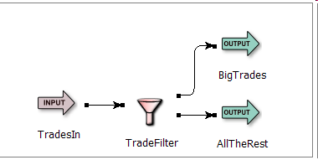
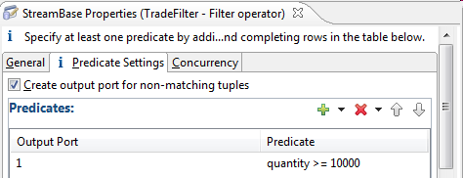
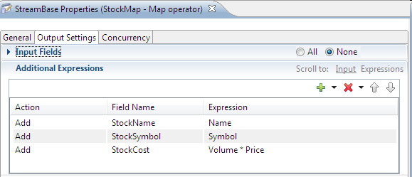
Operators Examples – cont.
Filter operator
Map operator

Slide 11

Sybase (Aleri)
Background
Sybase acquired Aleri (in early 2010), that acquired Coral8
in early 2009. SAP announced Sybase acquisition in May 2010, which makes all big companies offering event-processing capabilities.
CCL is the original Coral8 language, a descendent of the academic stream project in Stanford, and the CQL language, the language is an hybrid language: SQL extension with some pattern primitives.
Sybase has several “EP platforms” and is trying to consolidate them.
Notes:
Free trial version after registration.

Slide 12
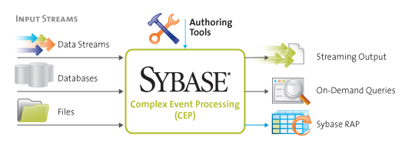
Sybase Architecture Diagram

Slide 13
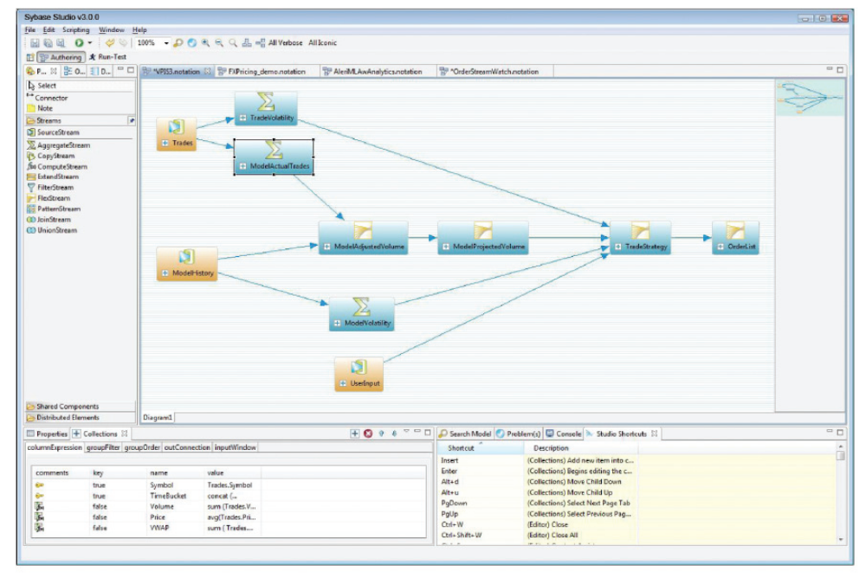
Sybase CCL Studio

Slide 14
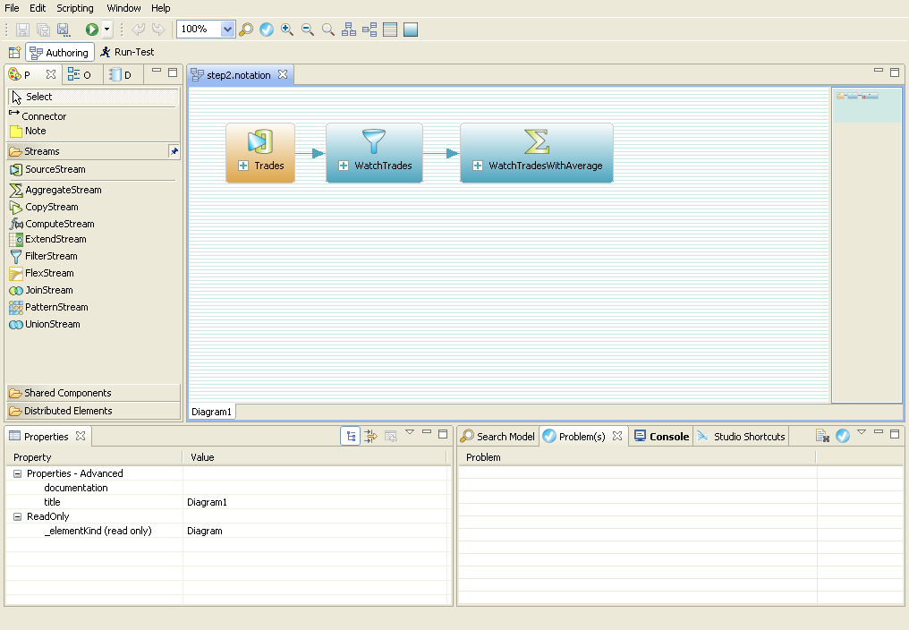
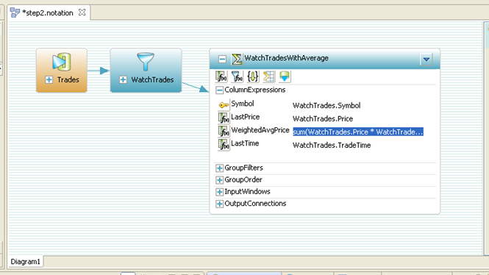
Sybase CCL Studio

Slide 15
Sybase CCL Operators
Filters
Various kinds of windows
  Sliding, jumping, counting, and others
Aggregators to aggregate state over windows
  Count, Max, Min, Avg, Sum, StdDev etc.
Transformers - transform messages and evaluate expressions
Joiners to correlate streams
  Stream-to-window correlations, stream-to-historical data correlations, inner/outer joiners, etc.
A GroupBy clause - allows applications to distinguish states
by individual column definitions
Matching

Slide 16
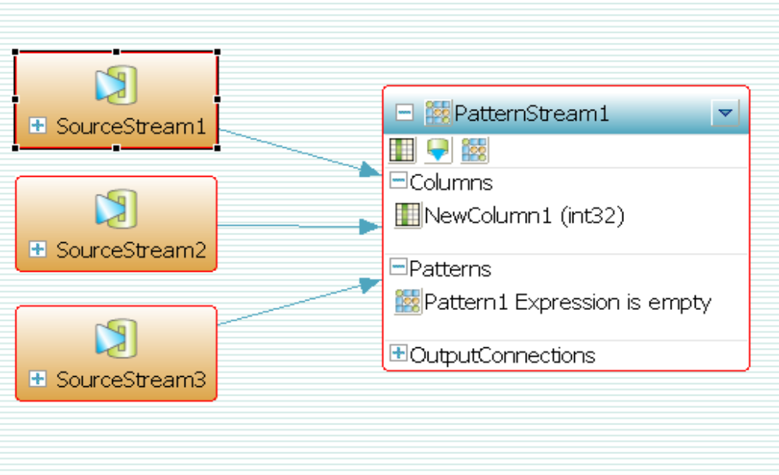
Pattern Matching

Slide 17
Pattern Matching – cont.
A possible theft condition, when there has been a product reading on a shelf, followed by a non-occurrence of a checkout on that product, followed by a reading of the product at a scanner near the door.
within 12 hours
from
ShelfReading[TagId=tag; ProductName=pname] as onShelf,
CounterReading[TagId=tag] as checkout,
ExitReading[TagId=tag; AreaId=area] as exit
on onShelf fby not(checkout) fby exit
output [TagId=t; ProductName=pname; AreaId=area];

Slide 18
Pattern Matching – cont.
Raise an alert if a user tries to log in to an account unsuccessfully three times.
within 5 minutes
from
LoginAttempt[IpAddress=ip; Account=acct; Result=0] as login1,
LoginAttempt[IpAddress=ip; Account=acct; Result=0] as login2,
LoginAttempt[IpAddress=ip; Account=acct; Result=0] as login3,
LoginAttempt[IpAddress=ip; Account=acct; Result=1] as login4
on (login1 fby login2 fby login3) and not(login4)
output [Account=acct];

Slide 19

Apama
Background
Apama started as academic project in Cambridge UK, the only one
of the original EP start-ups established in the late 1990-ies that survived.
Acquired in 2005 by Progress, and is considered one of the top divisions.
Currently considered as the leading vendor in the market (in terms of number of customers and revenues).
The language is imperative, looks like C or Java
  But not object oriented
Notes:
No free downloadable…

Slide 20
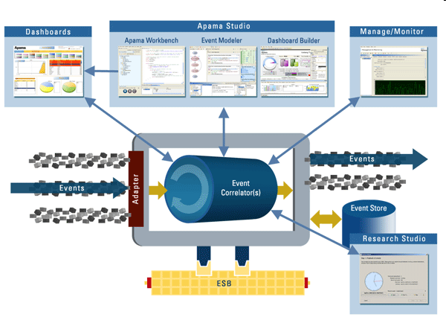
Apama

Slide 21
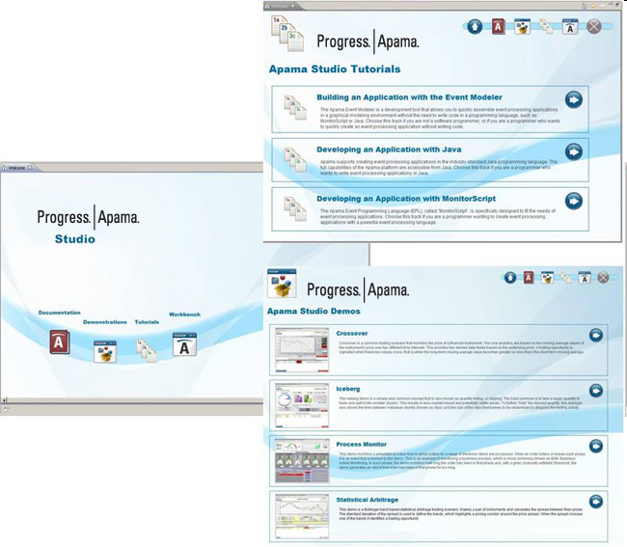
Apama Studio

Slide 22
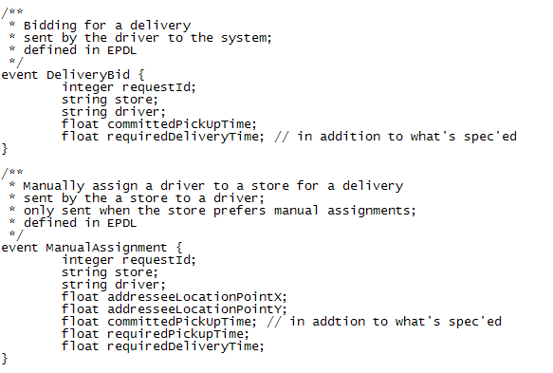
FFD Examples

Slide 23
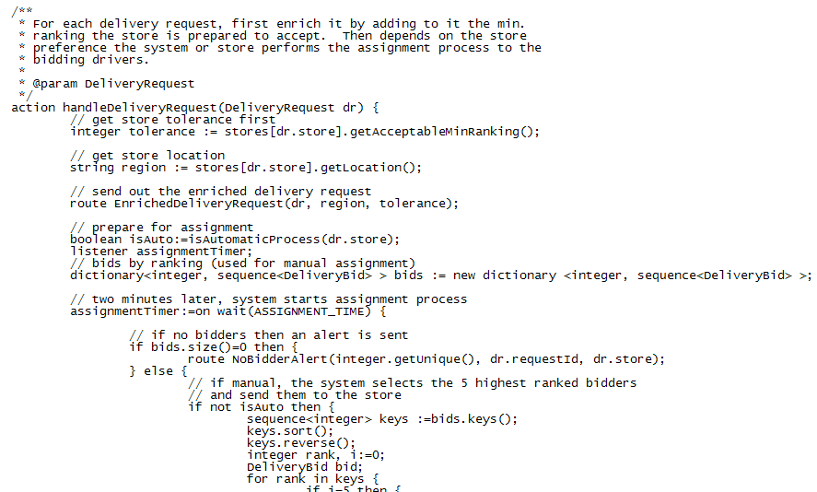
FFD Examples

Slide 24
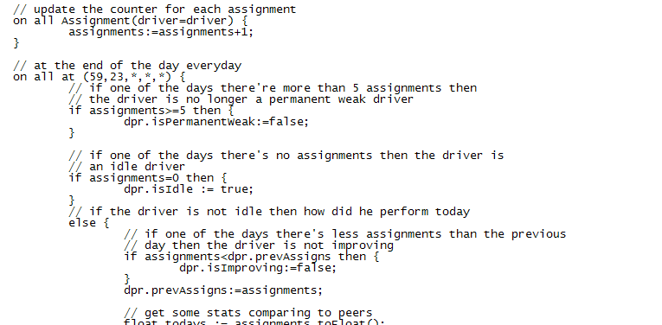
FFD Examples

Slide 25
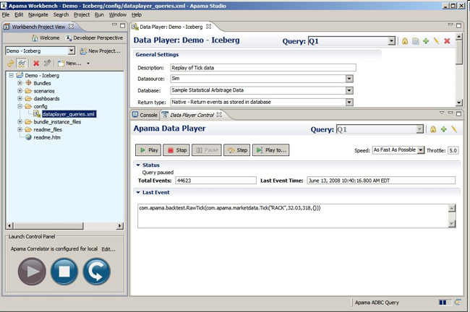
Apama Data Player

Slide 26

RuleCore
Background
Small company based in Sweden
The language is based on ECA rules
Completely event-driven, easy to integrate
  Uses standards: XML, DOM, XML Schema, XPath and XSLT
Event based run-time monitoring
SAAS (Software as A Service)
  RuleCore was first to introduce SAAS in event processing
Notes:
Provide a free demo account for academic purposes.

Slide 27
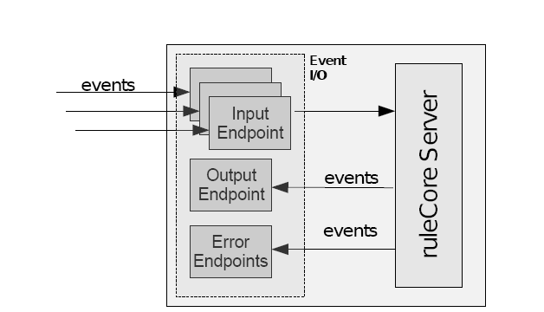
RuleCore - SAAS
Business model – charging per incoming event
Subscription to the server using service instance identified by id
Endpoint – JMS queue, Web service or e-mail
  A single open connection at a time for input and output endpoint
  for the same service instance

Slide 28
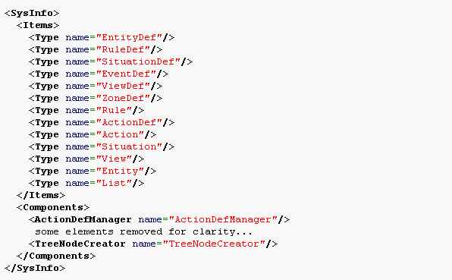
Empty Application

Slide 29
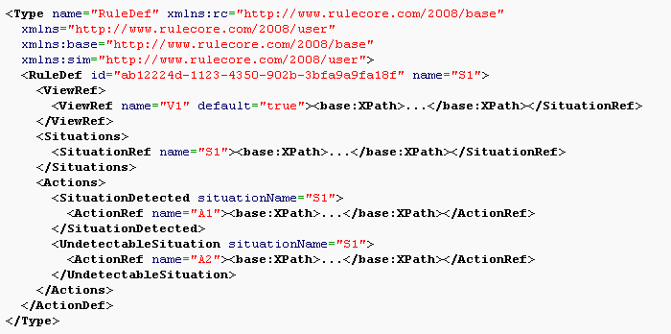
RuleDef Element

Slide 30
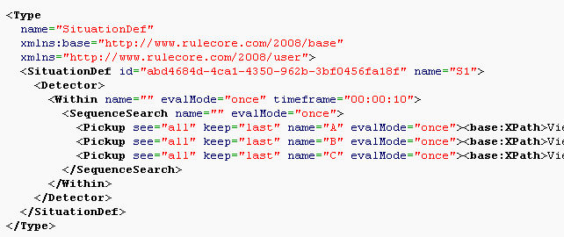
SituationDef Element

Slide 31
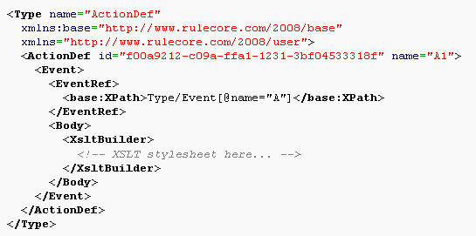
ActionDef Element

Slide 32
IBM WebSphere Business Events
Background
Was released in June 2008.
Based on the Aptsoft software, acquired in early 2008.
Application development using GUI, targeting a business user.
Works in “backward” event processing mode.
There is a hosted environment with WBE already installed - http://www.ibm.com/developerworks/downloads/soasandbox/customer.html?cm_sp=MTE13131
Notes:
Provide a free access to remote server.

Slide 33
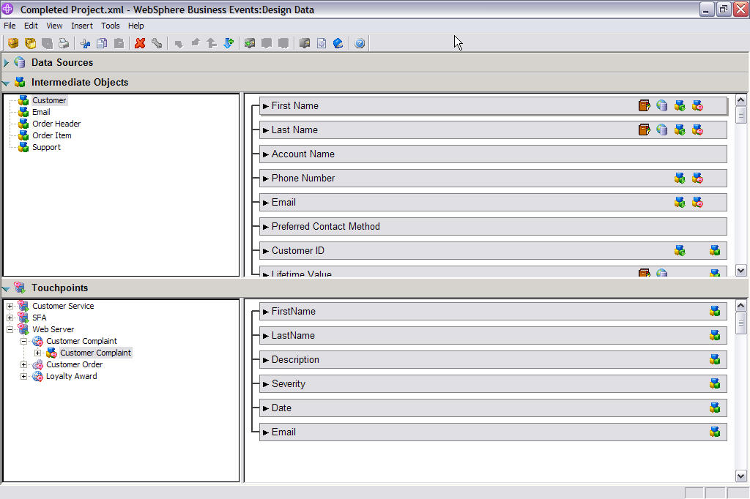
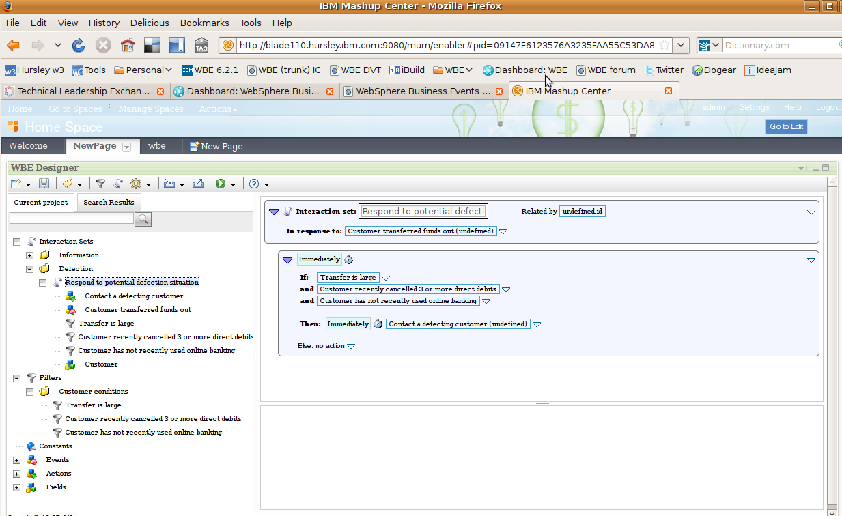
WBE – Development Environment

Slide 34
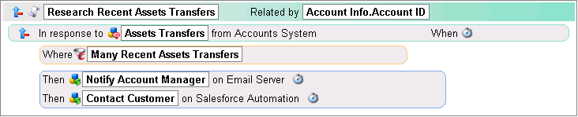
WBE – Business Policies (EPAs) – cont.
Whenever transfer occurs more than once in a month, then the Account Manager should be notified and Sales should contact the customer.

Slide 35
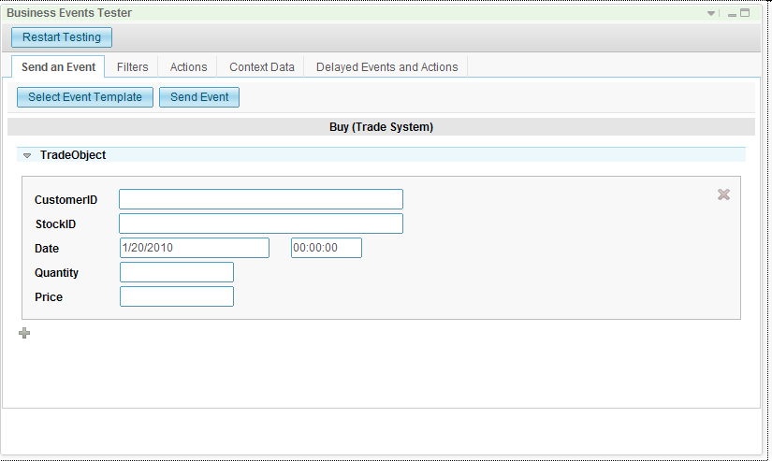
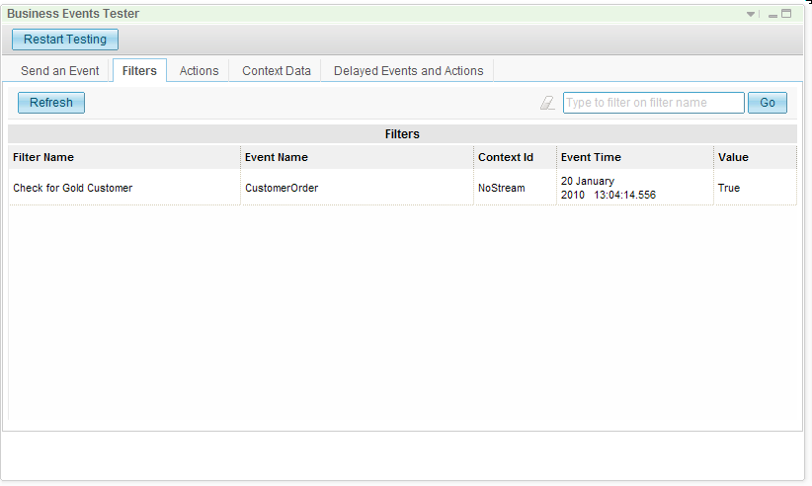
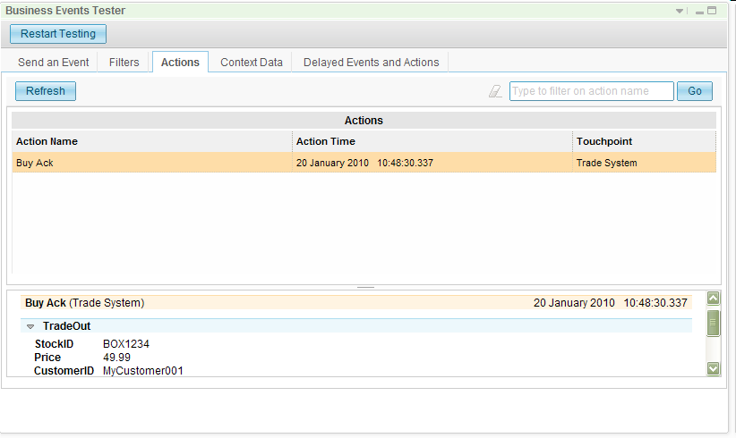
WBE – Testing Environment

Slide 36
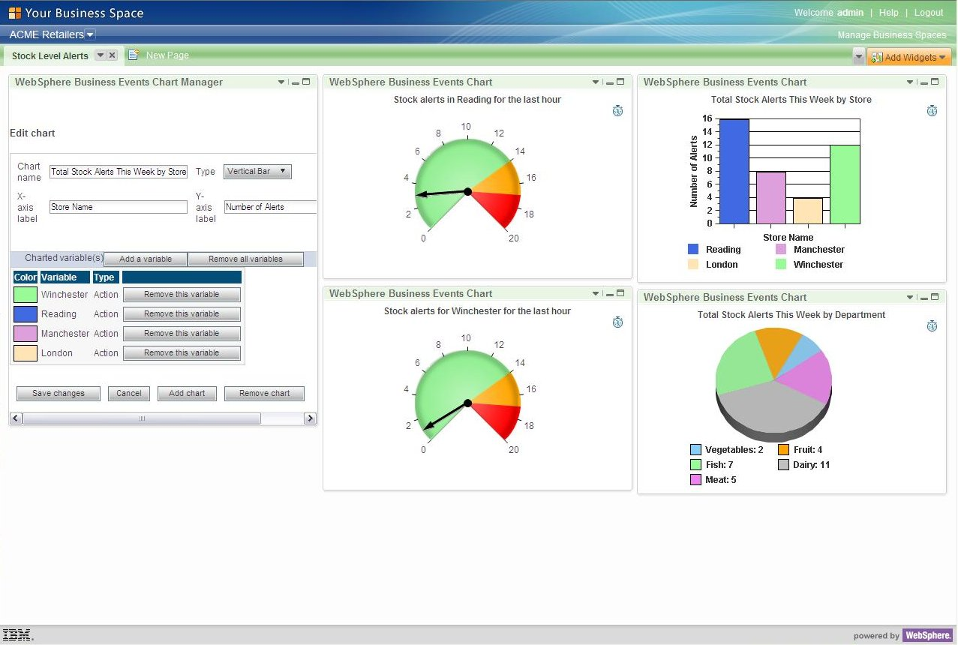
WBE – Dashboards

Slide 37
Microsoft StreamInsight
Background
Released as part of Microsoft SQL Server in 2010
A derivative of a research project that became a product
.NET development environment with LINQ queries
Notes:
Free downloadable installation of the entire environment.

Slide 38
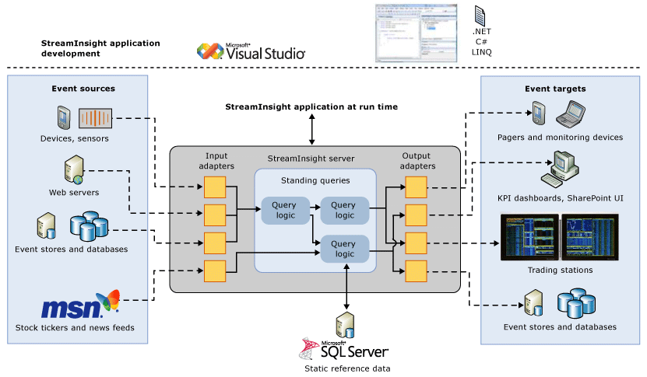
Microsoft StreamInsight

Slide 39
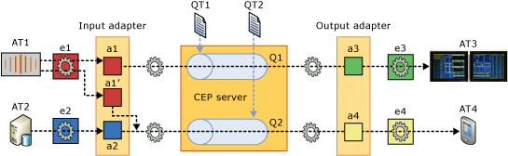
Key Features
Highly optimized performance and data throughput
  Optimized for parallel execution, employees in-memory cashes,
  incremental result computation
.NET development environment
  Writing CEP applications using Visual C#
  LINQ (Language Integrated Query) as embedded query language
Provides functionality for handling out-of-order events
Supports event intervals

Slide 40
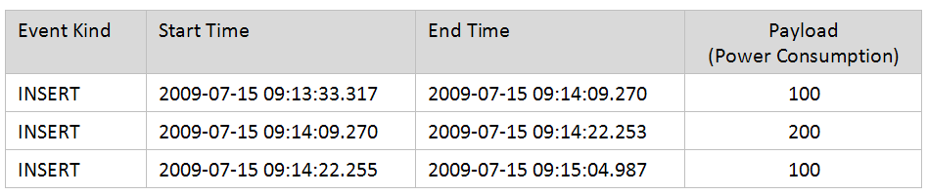
Event Interval
Supports event interval

Slide 41
Event Type
Event type and input stream definition (C#)
public class PayloadType
{
public double value;
public PayloadType () { }
public PayloadType (double i) { value = i; }
}
CEPStream<PayloadType> inputStream1 =
CepStream<PayloadType>.CreateFromUnTypedFactory<InputAdapterFactory,Config>(
streamName, eventShape, myconfig)

Slide 42
Query Definition (LINQ)
Filter events with “value” < 10
CepStream<PayloadType> outputStream = from e in inputStream
where e.value < 10
select e;
Aggregation over time window
var snapshotAgg = from w in inputStream.Snapshot()
select new { sum = w.Sum(e → e.i),
avg = w.Avg(e → e.f),
count = w.Count() };
Matching events from different streams
var equiJoin = from e1 in stream1 join e2 in stream2
on e1.i equals e2.i
select new { e1.i, e1.j, e2.j };

Slide 43
Additional Features
Event flow debugger
  View query plan for a given query
  Inspect all events produced on all streams
  Step through the trace of query execution
  Step through the event stream one event at a time and watch its progress
  from one operator to the next
Root cause analysis
  “Look back" at the root cause - the sequence of operations or changes that caused the event to reach its present condition
Event propagation analysis
  Analyze the effects of an event down the stream either in terms of the changes the particular event itself goes through, or in terms of how it impacts other events, or causes the generation of new events

Slide 44

Esper EPL
Background
Open source project – but sold as OEM to some vendors
  BEA in the past, Event Zero
The most popular open source in that area.
EPL – Event Processing Language
  SQL like language components embeddable in java
  Some of the functionality needs to be written in Java
Esper for Java & Nesper for .NET
There is an attempt to create a commercial version: “EsperTech”.
Notes:
Open source – free downloadable

Slide 45
Event Representation
Supports event-type inheritance and polymorphism
Events can be plain Java objects, XML and java.util.Map including nested objects and hierarchical maps
Event properties can be simple, indexed, mapped or nested

Slide 46
Event Representation – cont.
public class TxnEventBase {
private String transactionId;
private long timestamp;
public TxnEventBase(String transactionId, long timestamp) {
this.transactionId = transactionId;
this.timestamp = timestamp;
}
…
}
public class TxnEventA extends TxnEventBase {
private String customerId;
public TxnEventA(String transactionId, long timestamp, String customerId) {
super(transactionId, timestamp);
this.customerId = customerId;
}
public String getCustomerId() {
return customerId;
}
}

Slide 47

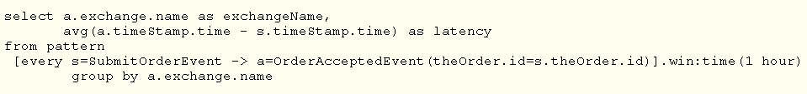
Pattern Matching
Calculate the delay between event of order submission and its acceptence.
Calculate average orders acceptence latency over the last hour.
Check if the order is not accepted within 30 minues of being submitted.

Slide 48
Esper - Comments
There is no graphical user interface
  However it is easy to connect the project to any java IDE
Allows debugging through any java debugger, i.e. Eclipse debugger
Input events can be provided from file or manually
Output is provided in text
BidRequest { requestId = 1, store = store_1, location = epia.flower.event.Point@1c7980c, pickupTime = 3600, deliveryTime = 7200, storeManual = false}

Slide 49

ETALIS
Background
ETALIS is running on Prolog systems while being implemented
by java and prolog (logic) programming
Logic programming is the use of logic as both a declarative and procedural representation language
The program logic is expressed in terms of relations
  Represented as facts and rules
  Execution is triggered by running queries over these relations
ETALIS allows very efficient deductive reasoning of complex events, situations and events-triggered actions
  Based on backward chaining of rules

Slide 50
ETALIS Features
Sequence, conjunction, disjunction, negation etc.
Support for time and event count-based sliding windows
Event aggregation for count, sum, min and max
Event filtering, enrichment, projection, translation etc.
Processing of out-of-order events (i.e. events that are delayed due to different circumstances e.g. network anomalies etc.)

Slide 51
ETALIS – Event Definition
An event has the following form:
  evName is a name (type) of an event
  (T1, T2) is an interval on which an event is defined
  (X1,...,Xn) is a list of attributes (data) carried by an event
event(E) - executes an event in the current datime moment
event(E,datime(Y,M,D,H,Min,S)) - executes an event in the datime
moment given as an argument
event(E,[Datime1,Datime2]) - executes an event in the datime interval
execute_event_stream_file(EventStreamFile) - execute an entire file
of events defined as above

Slide 52
FFD Example
% change assignment if handover detected
assignment(DeliveryRequestId,StoreId,ToCoordinates,DeliveryTime,DriverIdB,ScheduledPickupTime) ←
assignment(DeliveryRequestId,StoreId,ToCoordinates,DeliveryTime,DriverIdA,
ScheduledPickupTime) seq handover(DeliveryRequestId,DriverIdA,DriverIdB)
where (store_record(StoreId,_MinRank,automatic),driver_record(DriverIdA,Ranking1),
driver_record(DriverIdB,Ranking2),Ranking1 =< Ranking2)
% pick_up_alert is reported if a pick_up_confirmation has not been reported within 5 mins
pick_up_alert(DeliveryRequestId,StoreId,DriverId,ScheduledPickupTime) ←
(check_pick_up(DeliveryRequestId,StoreId,DriverId, ScheduledPickupTime) fnot
% the delivery was not handed over to another driver
handover(DeliveryRequestId,DriverId,_DriverIdB) ) fnot
pick_up_confirmation(DeliveryRequestId,DriverId,_RealPickupTime)

Slide 53
Some Additional Languages
TIBCO: Rule language
Oracle: SQL extension
Starview: Agent oriented
Drools: Rule language (open source)
Prova: Logic programming (open source)
Event Zero: EPN based, with various components and embedded Esper
Open ESB: Intelligent Event Processor
  SQL extension based on Stanford’s CQL
Additional IBM languages:
  Netcool Impact Policy Language: imperative
  SPL (Spade): Stream language
Yahoo S4 (open source)
Pegasystems

